Slide 1

Dr. Michael Anderson
Staff Scientist
Boston Children’s Hospital
Boston, Massachusetts, United States

Slide 2
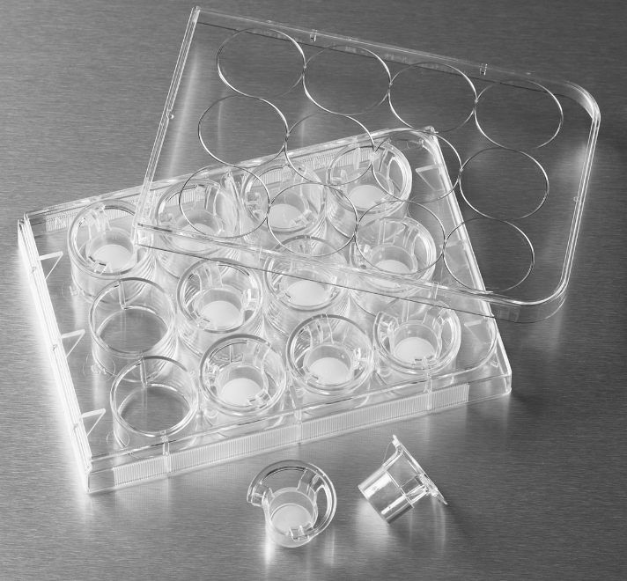
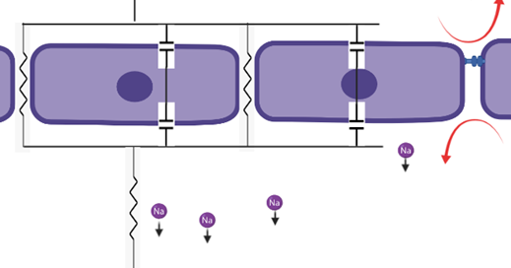
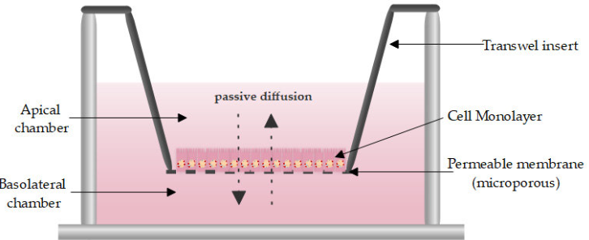
What is Transepithelial Electrical Resistance (TEER)?
Equivalent circuit diagram
Essentially, TEER measures resistance of ion movement through cells and cell gaps

Slide 3
Where is it used?
Common Usage
Mostly epithelial barrier research labs
Most common platform are transwell inserts
Used to monitor tight junctional formation in transwell polarized monolayers
Potential Future Usage
Ion flux through cell-cell gaps as a function of time, drug additions, genetic manipulations
Pairing electrophysiology with microscopy and microfluidics
Adapt to different biological models
Modify to explore more electrophysiology phenomena

Slide 4
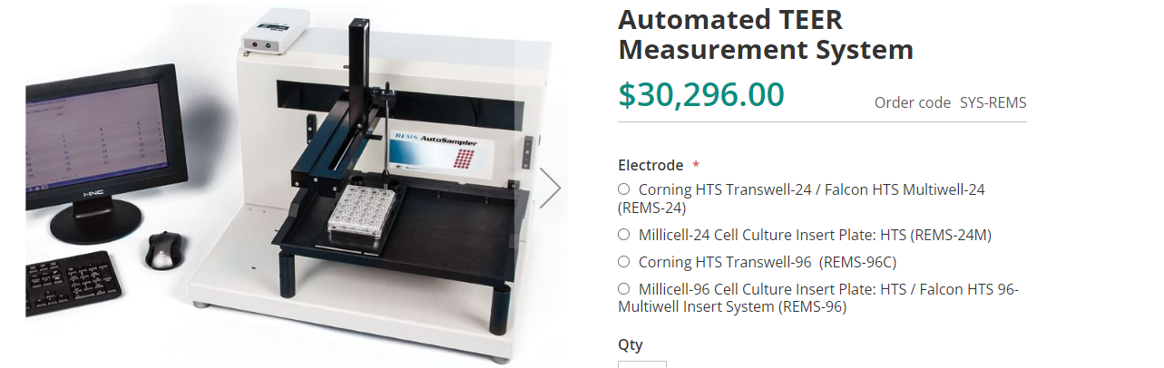
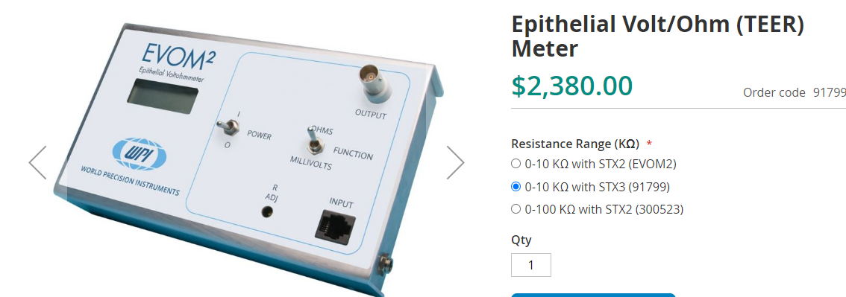
What is Currently Available?
World instrumentation is the commercial leader with TEER devices
EVOM 2 and 3 meters are affordable, but extremely limited in capabilities
Automated system is much more repeatable and automated, but still restrictive with platform choice and no incubation and is expensive
No sufficient open-source alternative exists

Slide 5
Flexi-TEER Goals
Flexible. Basic unit can attach to almost any electrode-based device, and both generate the needed current and read off resulting voltage
Modulatable. Alter any relevant parameters of device from frequency, peak amplitude, duty-cycle, read frequency, etc.
Reliable. All electrical characteristics are documented. No one wants to use something if they cant trust it
Affordable. Greatly expand what labs are able to leverage TEER devices to achieve new experiments and build more repeatable cell model system.

Slide 6
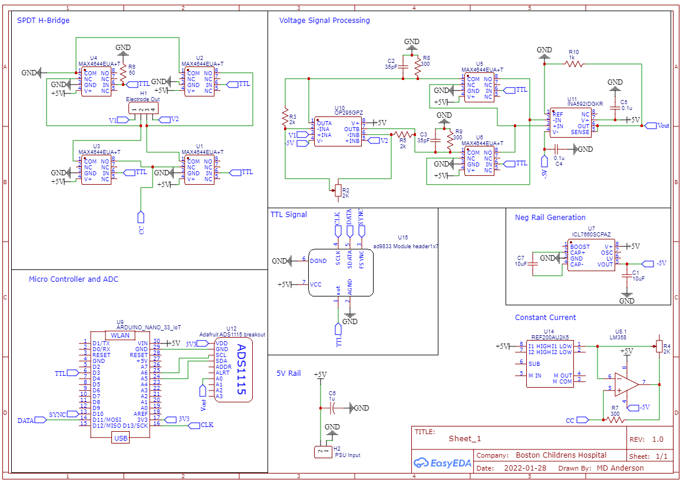
Current Status of Project and needs
Theory derived
Basic schematic is finished, and PCB designed
Needed Contributions
Electrical Engineering. I am a physicist and I need someone who understands practical implementation of electronics and refined PCB design
Accessory Design. We need accessories to use the device with. Examples are casing for PCB, incubation chamber to hold transwell inserts, reliably place electrodes and be sterilizable.
Electrode Design
Testing and Documentation. Building good guides and documentation and testing made equipment

Slide 7
What is in it for me and how to contact
Contribute to meaningful research and advancement of research into new areas
Have impact on research direction (how device is applied)
It is interesting!
Become a coauthor on papers pertaining to device
Contact
Email Michael Anderson at Michael.Anderson@childrens.Harvard.edu
Don’t need predefined role or ideas to join. We can discuss your role based on your interests and skill set

